Slide 1
Identifying Land Use Changes over time in Suburban Denver, CO using Landsat8 Imagery
Aaron Sigman
Utah State University
Civil and Environmental Engineering

Slide 2
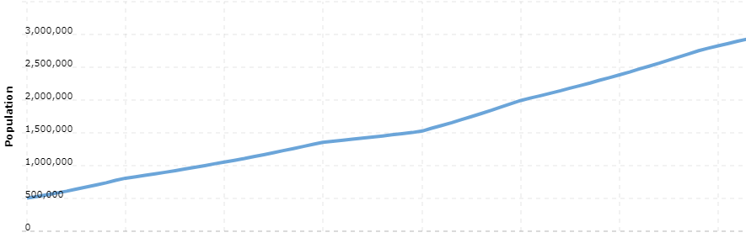
Background
Urban and suburban remote sensing can play many roles in understanding the distribution of land uses and land types
For growing suburban areas, the regions can be monitored for residential development, water reservoir storage capacity, and open space areas
This monitoring is important for many reasons including:
Zoning
Commerce development
Tax assessments
Transportation
Parks and recreation
Emergency management
Real estate development
1950
2020

Slide 3
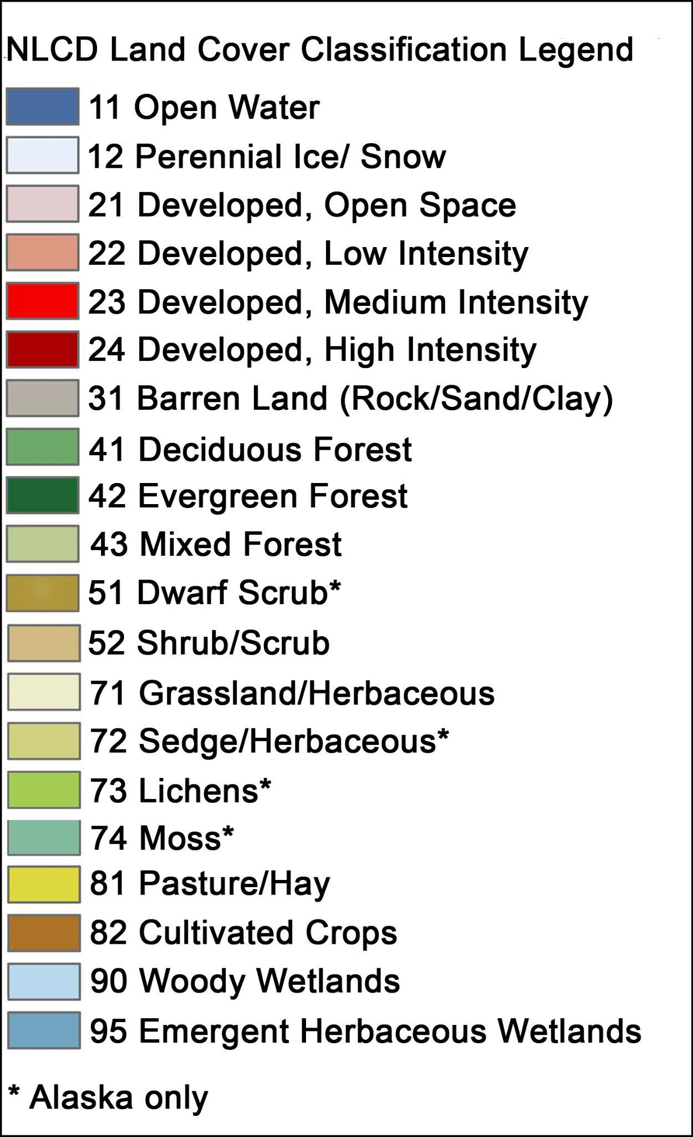
Objectives
Compare National Land Cover Database changes from years 2016 to 2019
Classify landsat8 imagery to land covers for multiple years
Compare results to NLCD changes
Identify regions of major change

Slide 4
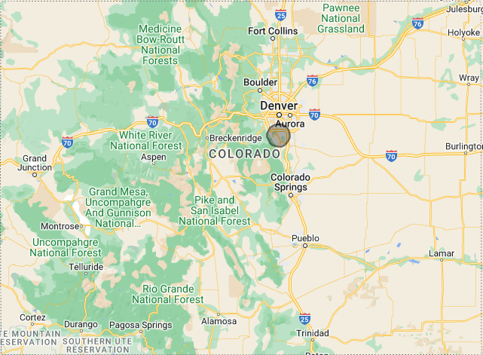
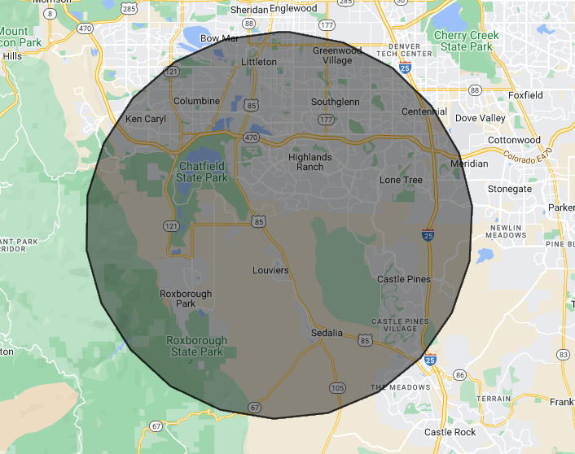
Study Area
Southwest metro area of Denver, Colorado, USA
Large, growing suburban developments
14 km radius, ~615 km²

Slide 5
Methods
Import landsat8 datasets
Clip to study area
Summer date with minimum cloud cover
2013, 2018, 2022
Classify study area
Selecting polygons utilizing true color, false color, and NDVI
Classification and Regression Tree
Compare changes in time
Compare results to NLCD results
Import NLCD datasets
2016 & 2019
Clip to study area
Classify study area
Compare changes in time

Slide 6
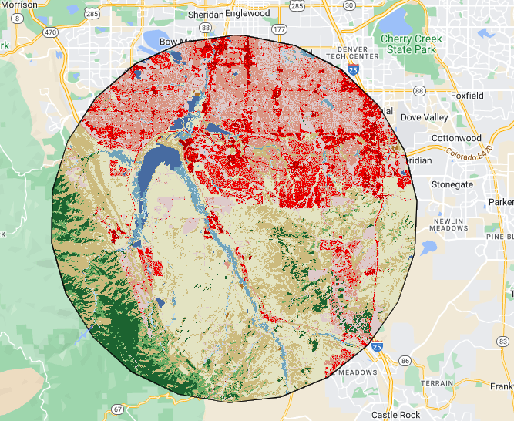

NLCD Data Visualization
2016
2019

Slide 7
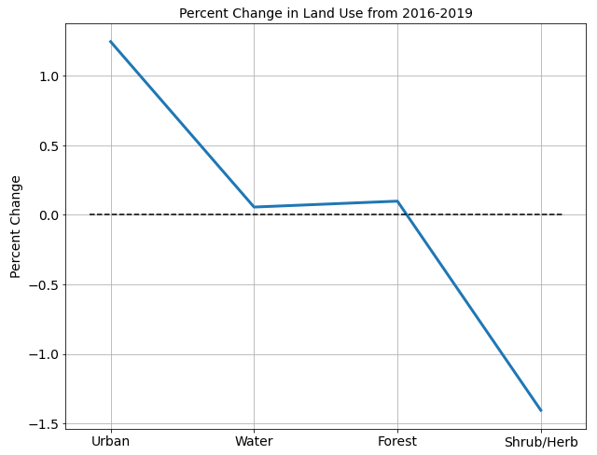
NLCD Changes
1.24% increase in Urban
<0.1% increase in Water and Forest
1.4% decrease in Shrubland

Slide 8
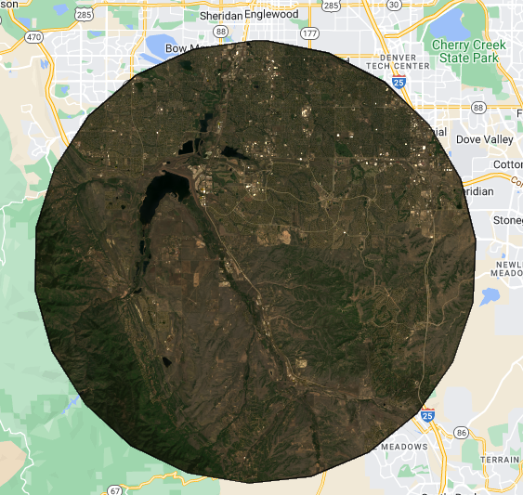
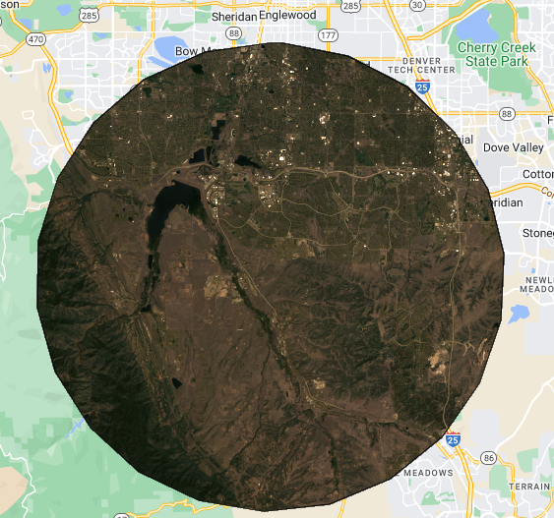
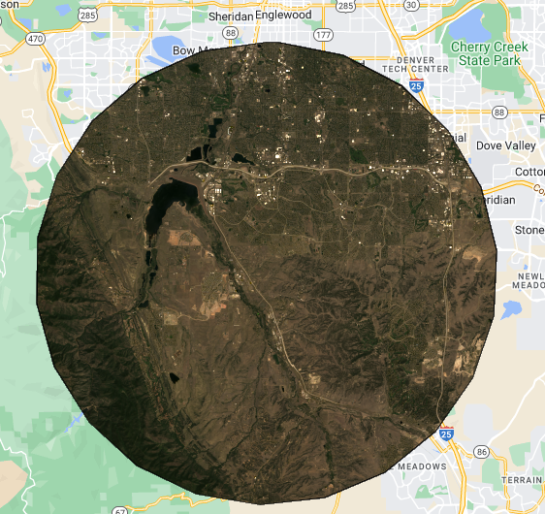
Landsat Visualization (True)
2013
2018
2022

Slide 9
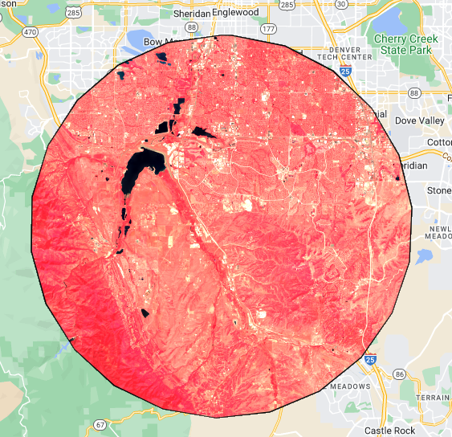
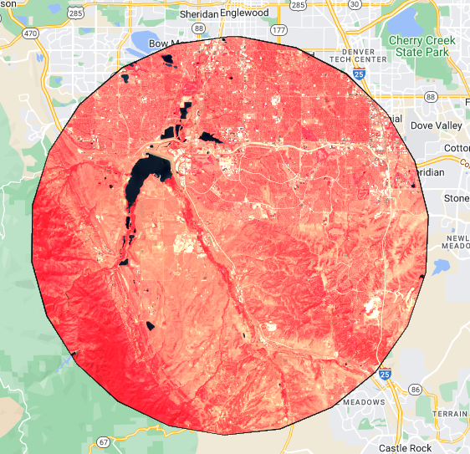
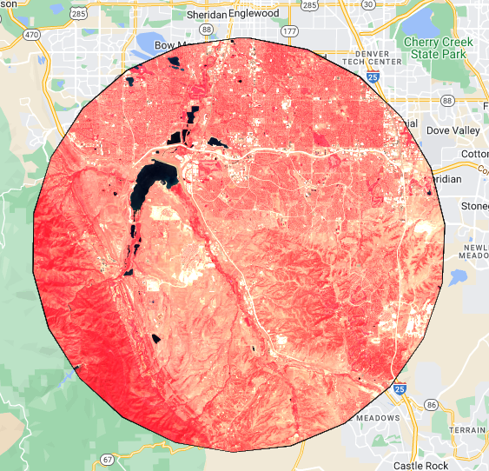
Landsat Visualization (False)
2013
2018
2022

Slide 10
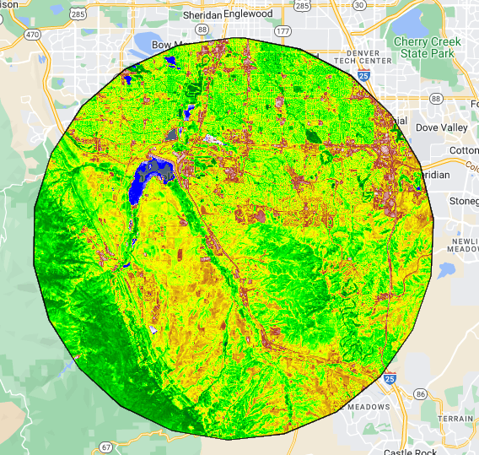
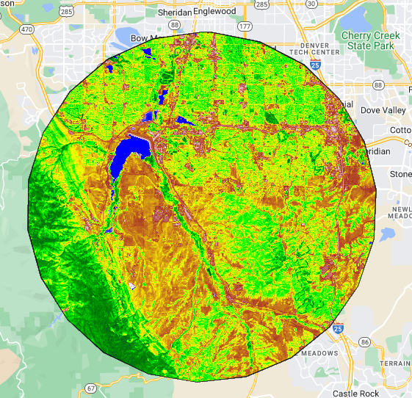
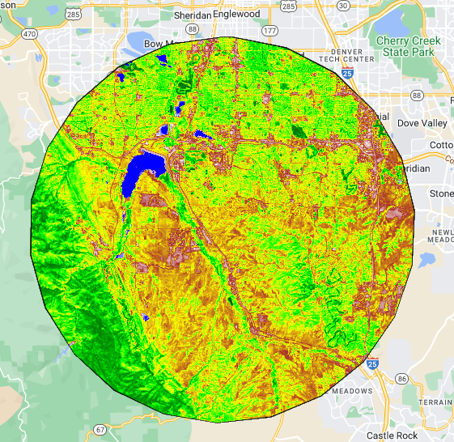
Landsat Visualization (NDVI)
2013
2018
2022

Slide 11
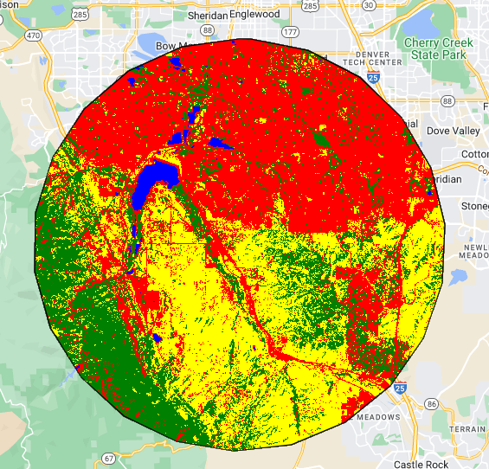
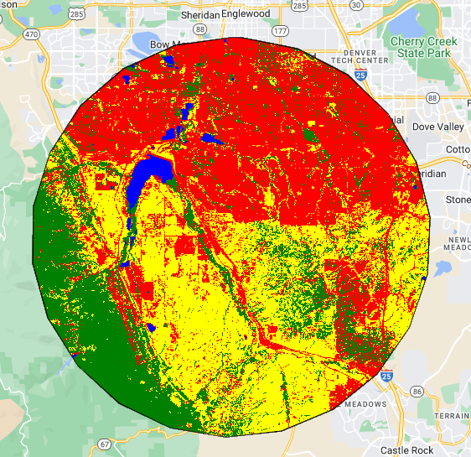
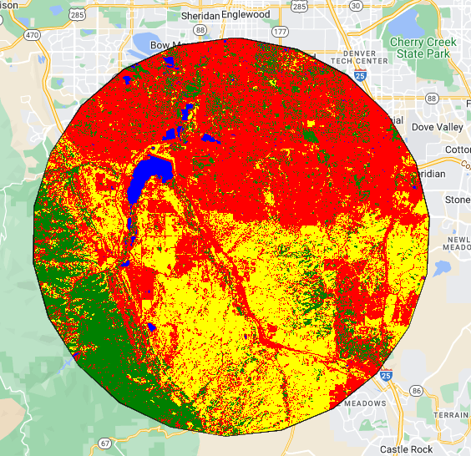
Landsat Classification
2013
2018
2022

Slide 12
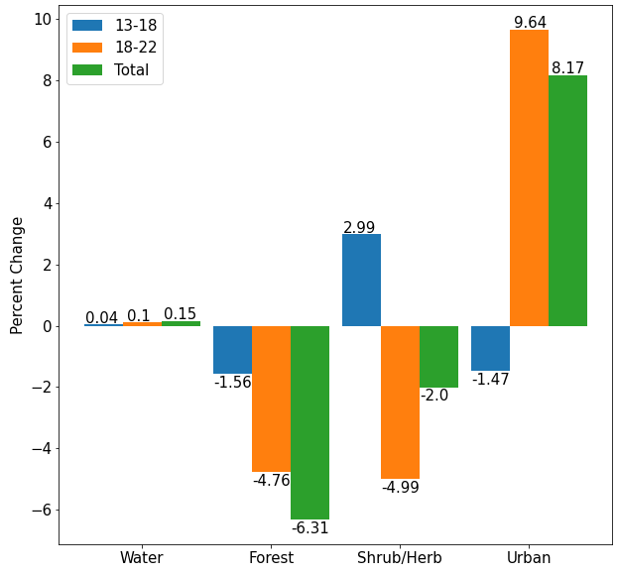
Results
Large increase in development ~8%
Decreases in Forest and Shrubland, ~6% and 2% respectively
Water stays about the same

Slide 13
Limitations
Resolution of landsat8 (30m) data may not capture more local changes in land cover
Comparison between NLCD and landsat classification may differ for multiple reasons
Differences in years & climatic conditions
Differences in classification methods & categories
Computing power limitations, limiting to a smaller study area

Slide 14
Conclusions
This initial pass at classifying multiple years of land cover does a decent job of identifying regions of change
Generally able to identify the amount of urban development seen over the past 10 years
This method has limitations in classification
https://github.com/Sigmanaj/S2023RemoteSensing/tree/main/TermProject

